Slide 1
Demonstrating high-scalability using
Kubernetes
Domain: Distributed Systems and Cloud Computing
Project ID: 6 Project by:
Project Incharges: Dr. K. Sagar, Smt. G. Vanitha Sana Simran K
Project Mentor: Mr. K. Kiran Prakash 160117733007

Slide 2
PRoblem StAtement
Today’s web applications offer multiple services to meet the needs of the customer. For example, a customer interacts with login, search, payment, and delivery services to get a product home delivered from Amazon.in.
A traditional (web) application would have all the services as part of a monolithic architecture, where one application runs/supports all the services. But a monolithic architecture based application often breaks under a fluctuating user demand.

Slide 3
Existing Solution
Virtual machines are the present way to manage and deploy applications with monolithic architecture. Virtual Machines consume a lot of space, take a lot of time to load, consume resources heavily and are hard to maintain.
Managing virtual machines in case of a fluctuating user traffic is a resource intensive task. If an underlying server supporting a VM goes down, some one has to step in to recreate it in another working server.

Slide 4
Proposed Solution
To solve this problem, a modern (web) application uses a micro-service architecture to decompose the business logic into discrete micro-services that are easy to deploy, maintain, and scale.
Microservices are often containerised using platforms like Docker and are managed by an orchestration framework like Kubernetes. The aim of this project is to demonstrate high-scalability and fault-tolerance (to a certain extent) in micro-service oriented web-application.

Slide 5
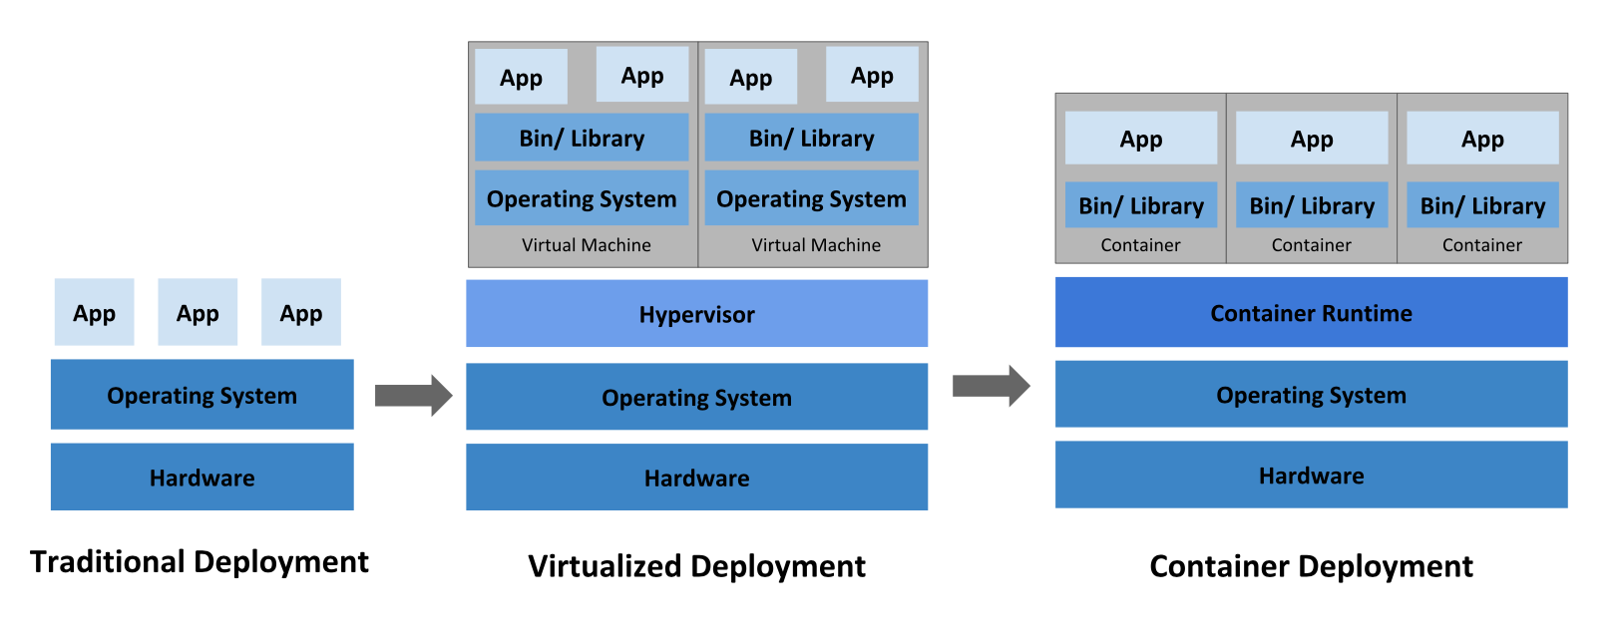
Proposed Solution

Slide 6

LiteRAtuRe suRvey
BASE PAPER 1) Building Modern Clouds: Using Docker, Kubernetes and Google Cloud Platform
Development of a modern cloud infrastructure or DevOps implementation that both Docker and Kubernetes have revolutionised the era of software development and operations
Explains concepts like Docker containers and Kubernetes
Shows the working and implementation of Kubernetes platform
Hosts Wordpress using docker and Kubernetes

Slide 7
LiteRAtuRe suRvey
BASE PAPER 2) Self-hosted Kubernetes: Deploying docker container locally with Minikube
Deploys the container orchestration tool Kubernetes on a local system with a Docker sample container.
Shows how the configurations and management needed for a Docker container is set successfully on the local system before it is deployed onto the cloud or on the premise.
Shows how on-premise deployment use case is very important in domains such as finance and healthcare where organisations hesitate to upload confidential information on to the cloud for security reasons but still require scaling of their applications.

Slide 8
ImplementAtion
STEP 1: Development of a Web Application
Recipe System called ‘Foodie’ using react.js, node.js with restful API and MySql
Features like:
Create account
Login (token based authentication)
Search for recipes based on ingredients
Share recipes across platforms**
Post and bookmark recipes**
* = Future scope

Slide 9
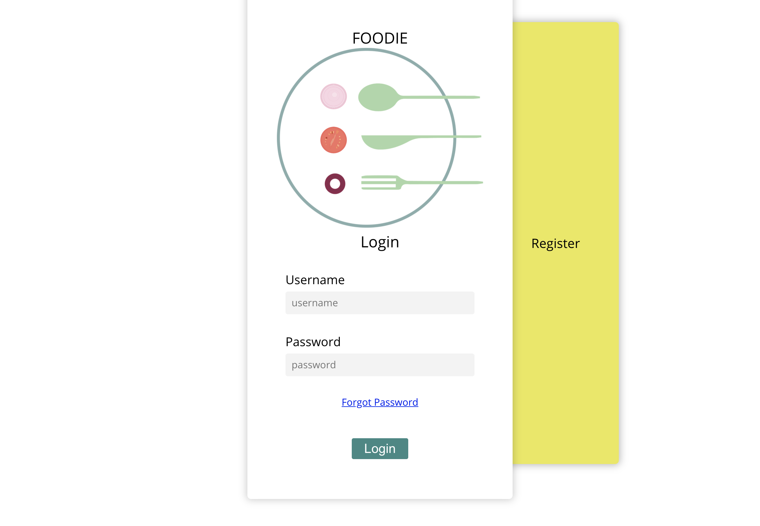
ImplementAtion
LOGIN SYSTEM

Slide 10
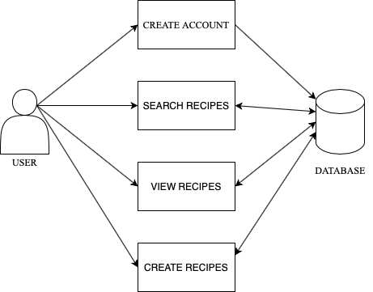
ImplementAtion

Slide 11
ImplementAtion
Step 2: Containerisation of the application using Docker
In Docker, a container is called as DockerFile. DockerFiles or images are used to “build” containers using the “docker build” command.
The build of the application defined in the DockerFile behaves exactly the same wherever it runs. The Docker client communicates with the Docker daemon to create containers

Slide 12
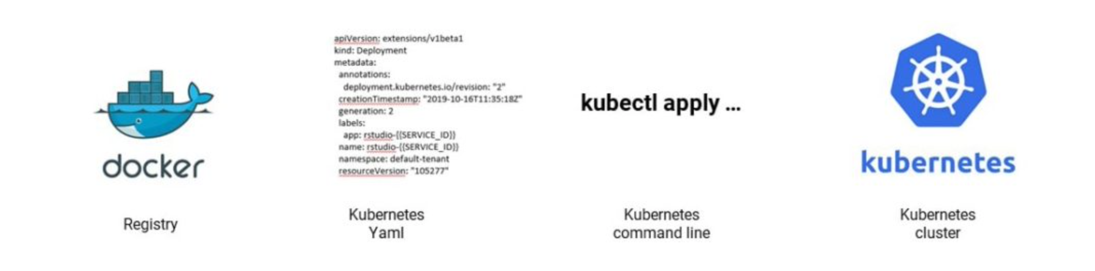
Docker and Kubernetes integration

Slide 13
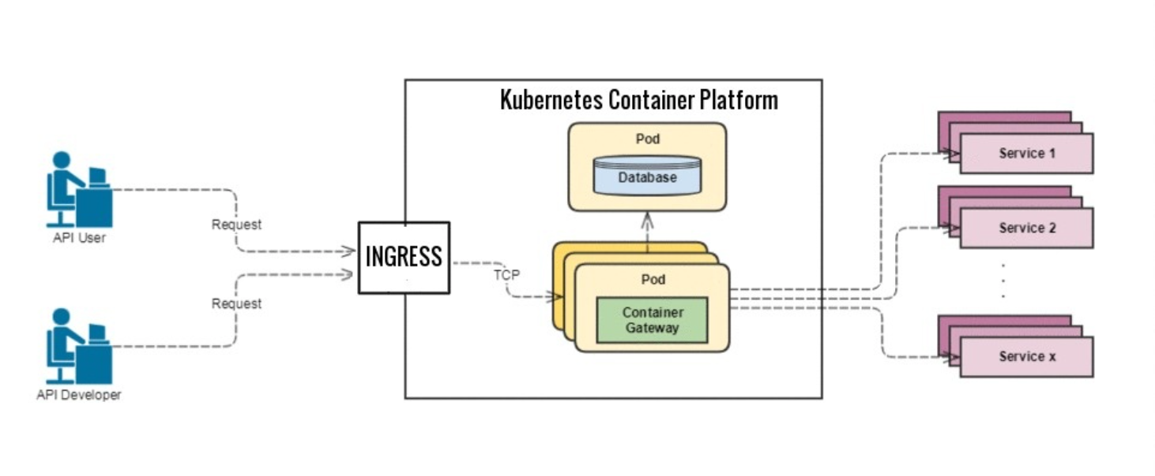
Working of Kubernetes
Step 3: Working of an application using Kubernetes

Slide 14
Demostrating high scalability
Using “Apache JMeter”, perform load testing on “Foodie” application to measure load handling and performance metric of the system

Slide 15
Future Scope
Implement other services to the “foodie” system.
Explore other features of Kubernetes
Implement automated deployment

Slide 16
References
R. Muddinagiri, S. Ambavane and S. Bayas, "Self-Hosted Kubernetes: Deploying Docker Containers Locally With Minikube," 2019 International Conference on Innovative Trends and Advances in Engineering and Technology (ICITAET), SHEGAON, India, 2019, pp. 239-243, doi: 10.1109/ICITAET47105.2019.9170208. , https://ieeexplore.ieee.org/document/9170208
J. Shah and D. Dubaria, "Building Modern Clouds: Using Docker, Kubernetes & Google Cloud Platform," 2019 IEEE 9th Annual Computing and Communication Workshop and Conference (CCWC), Las Vegas, NV, USA, 2019, pp. 0184-0189, doi: 10.1109/CCWC.2019.8666479., https://ieeexplore.ieee.org/document/8666479

Slide 17
THANK YOU

